Slide 1
ADF&G Title 16 Permit (Habitat)
By Keifer Kanayurak

Slide 2
Overview
The title 16 permit focuses on the preservation of anadromous fish (e.g. as salmon), wildlife and its respective habitat. Instead of focusing on the harvesting, the permit addresses land use activities along inhabited streams, sanctuaries, as well as other critical habitat serving as refuge.

Slide 3
Habitat Permit
There are several permits within the habitat section of ADF&G:
Fish Habitat Permits
Special Area Permits
Small Scale Mining Permits
General Permits
Notes:
Special area permits will be discussed in depth by another presentation

Slide 4
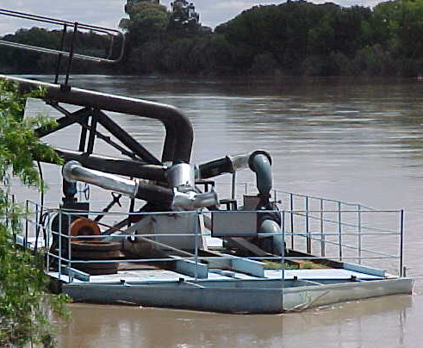
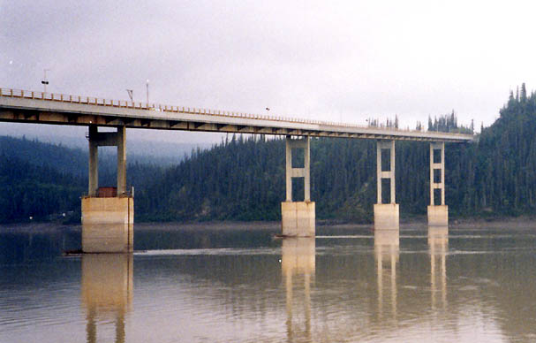
Fish Habitat Permit
Culvert/bridge installation, modification or removal
Water-crossings with motorized vehicles or equipment.
Mining for gold or sand & gravel.
Water withdrawal.
Bank stabilization or restoration.
Stream modification
Hydroelectric facility
Any other activity that may affect fish or fish habitat.
Notes:
docks/ramps & ice bridges.

Slide 5
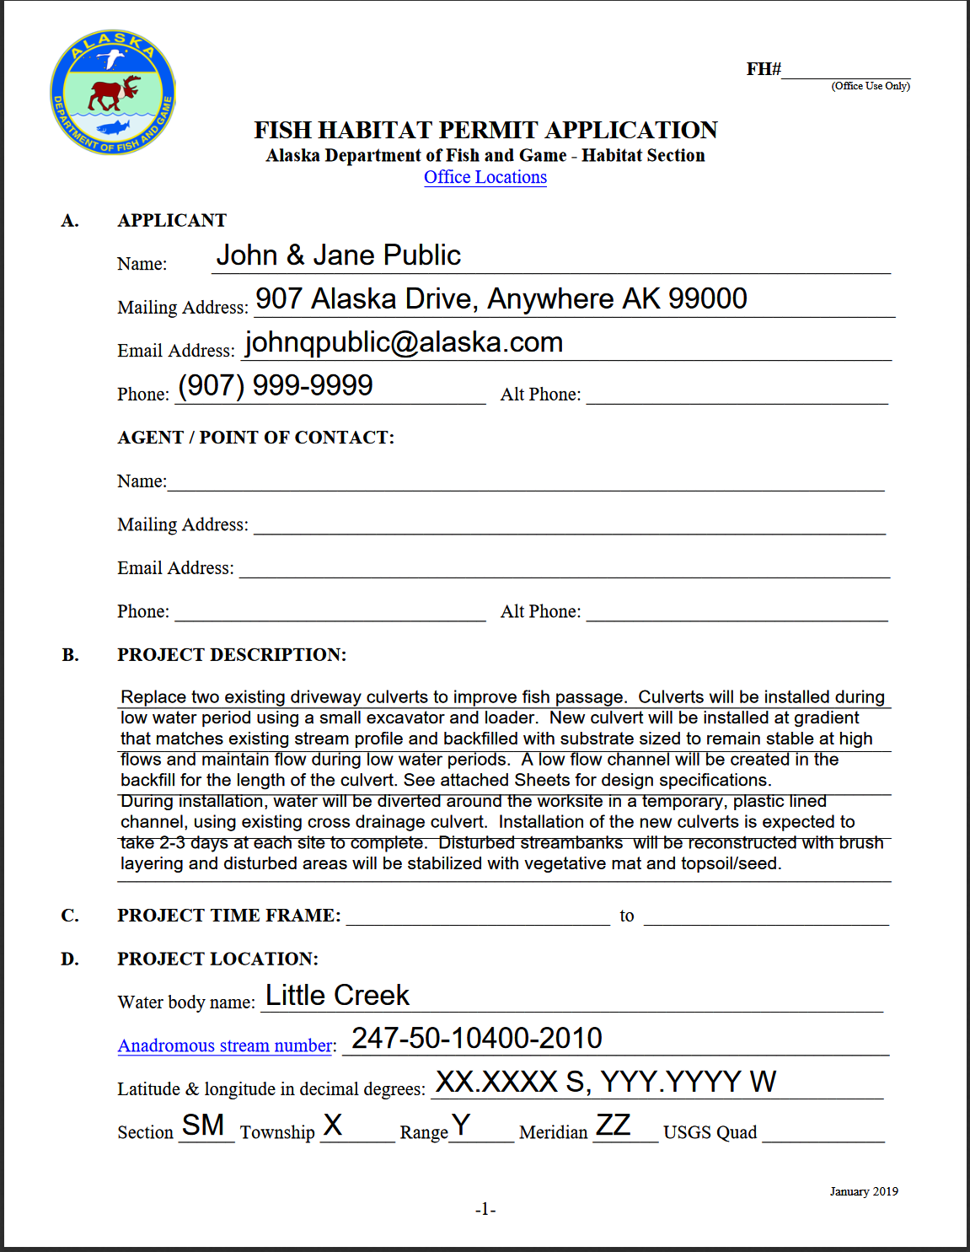
Applicant information
Contact information
Project description
Project timeframe
Project location
Waterbody characteristics
Short Description of in-water work
Any stream crossings
Any water withdrawal
Plans, specifications, aerial photographs, rehabilitation plans, or other supporting information
Notes:
If the project includes large areas of work, the amount of additional plans (or other supporting documentation) could increase the length of the entire permit. Or, if the project includes multiple locations that vary in scope, there would likely have to be separate permits with its respective, detailed information.

Slide 6
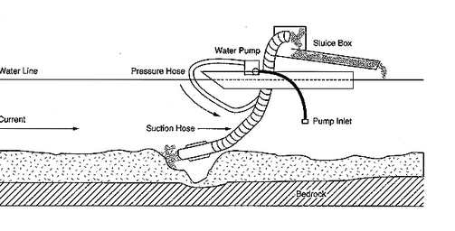
Small Scale Mining Permit
Use of a suction dredge with an intake diameter less than or equal to six inches and powered by a less than or equal to, 18 horsepower engine.
Use of a sluice box and suction pump (less than or equal to 18 horsepower) to process material gathered with hand tools.

Slide 7
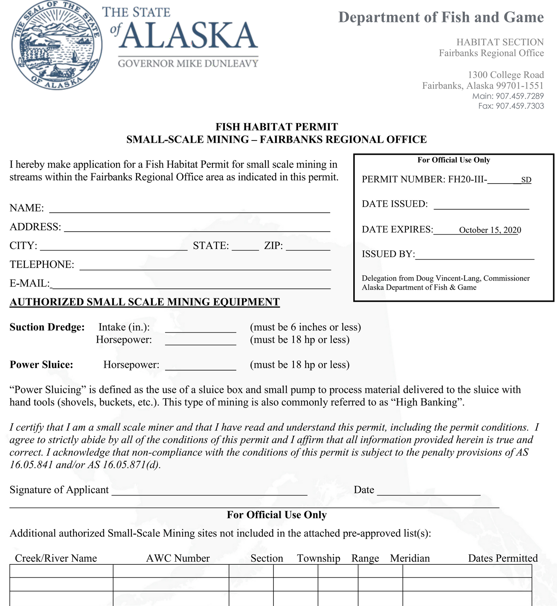
Applicant information
Description of equipment (specifications within requirements)
Each region could contain multiple pre-approved locations which would need to be coordinated with the respective regional office

Slide 8
General Permits
General permits exist for specified boat launchings, stream crossings, and special areas that see recurring use and have been proven to have low impact on fish & wildlife or their respective habitats.
Notes:
General permits include a list of locations where pre-approved activities can be performed by the general public.

Slide 9
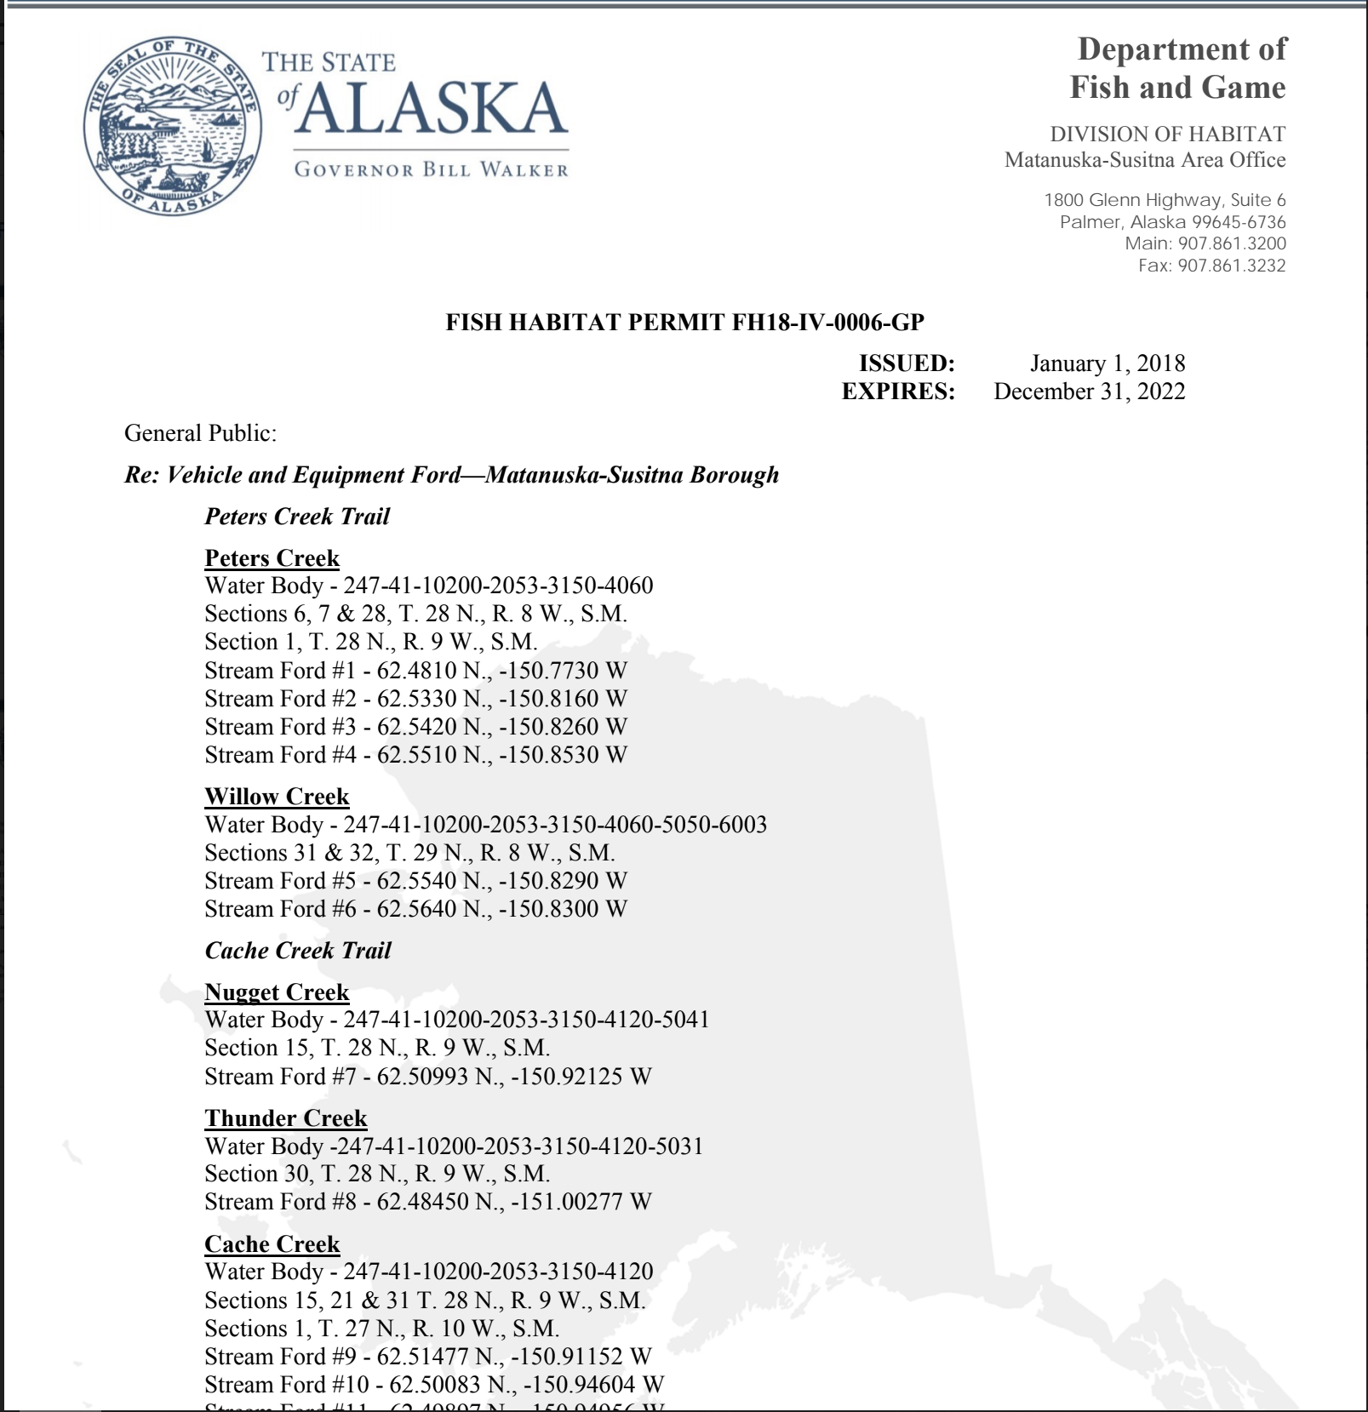
Some required information depending upon nature of activity:
Gross Vehicle Weight (GVWR)
No streambed or bank alteration, gravel removal, water use, or diversion is authorized under this permit.
Stream crossing shall be made as directly as possible
Vehicle operation only as necessary to safely cross
Notes:
Depending upon nature of the general permit some of the following information may be required.

Slide 10
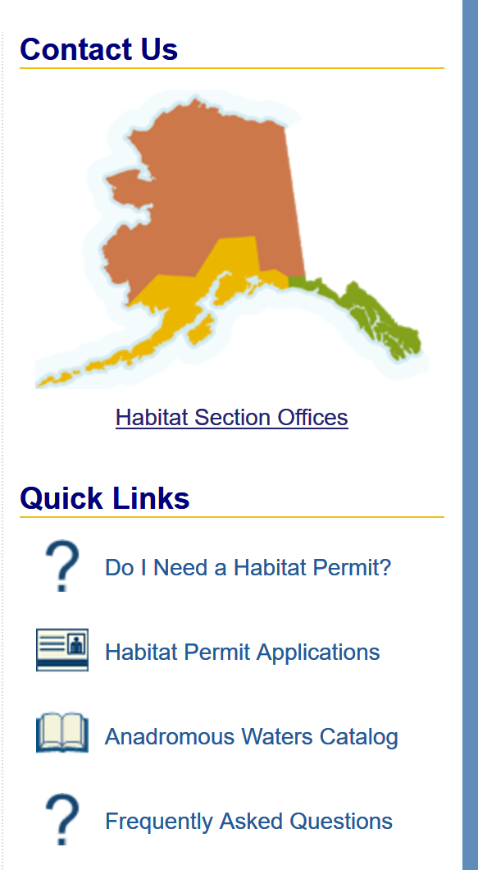
Information Resources
Varies by region (or project location within the region)
The ADF&G website includes a lot of helpful information
Notes:
The website includes a lot of helpful information as well as example permit applications.

Slide 11
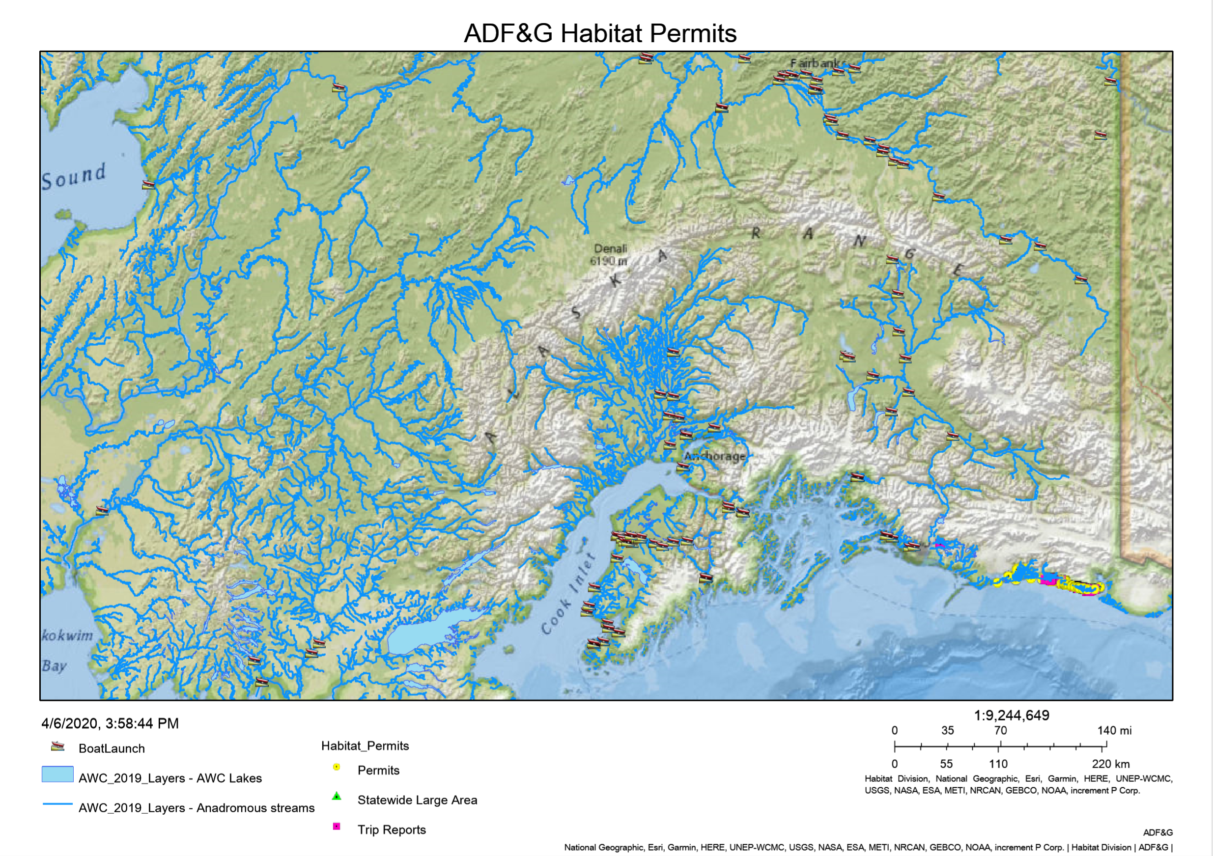
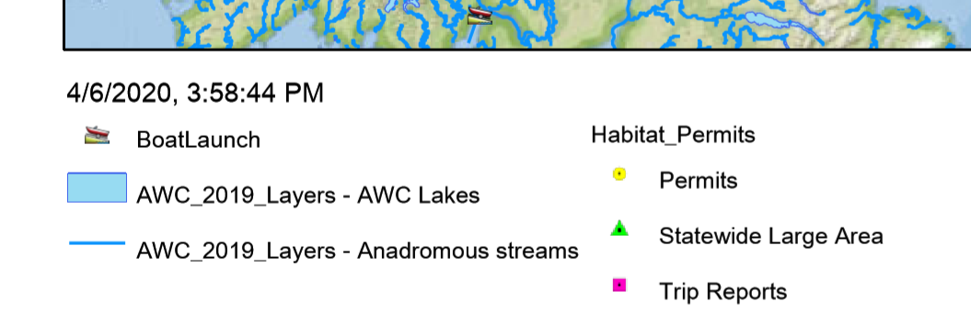
Notes:
The website includes an interactive map which includes general permit locations.

Slide 12
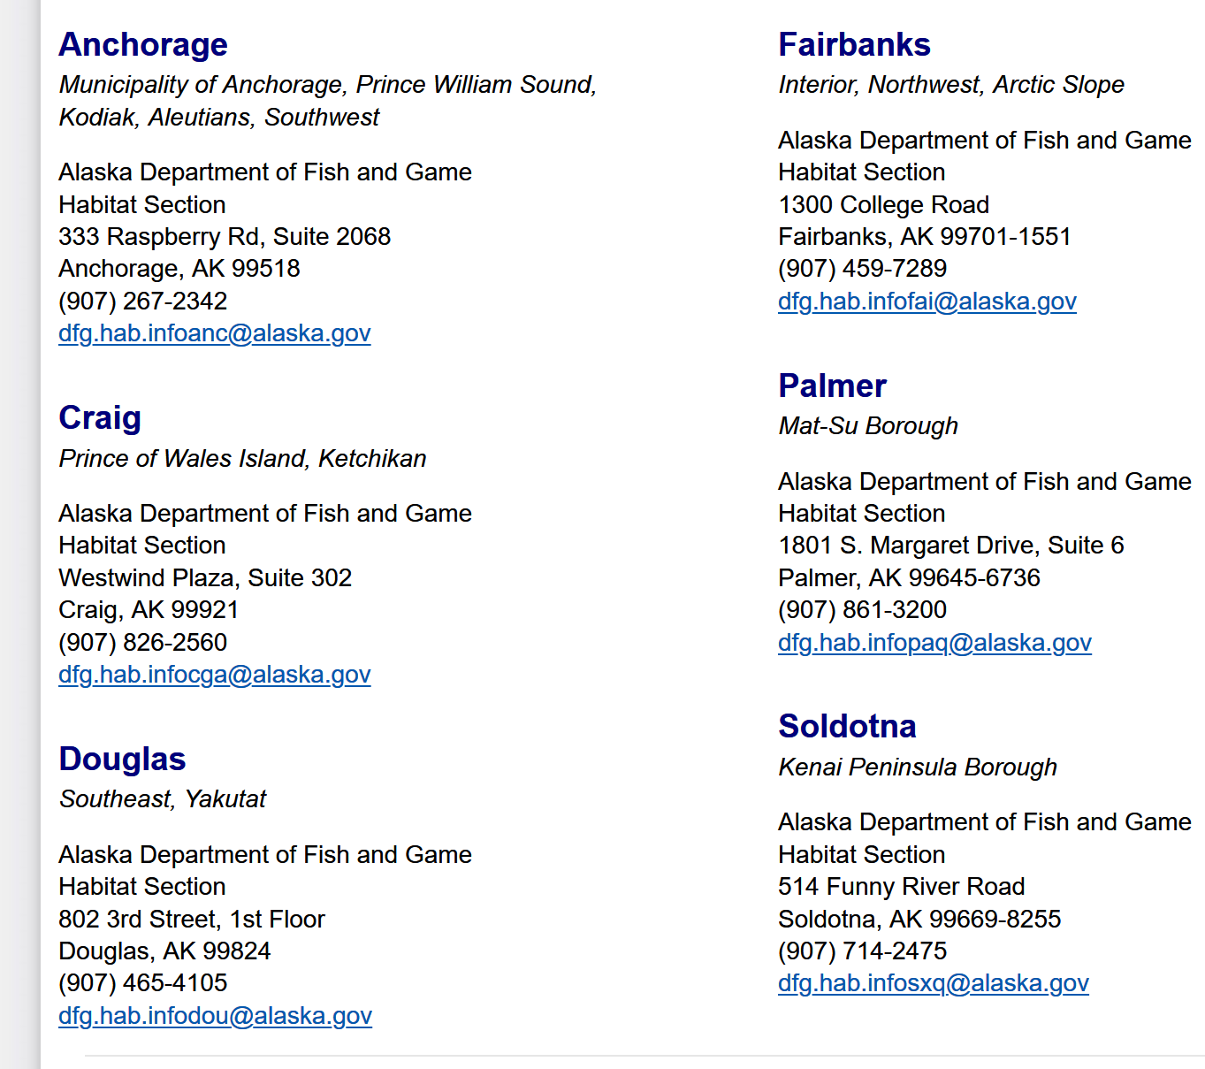
Any person or agency applying for a permit can simply contact the region office closest to the location of the project or activity.

Slide 13
Penalties
Depending upon the classification, the misdemeanor can result in jail time extending up to a year in jail or a monetary value, for bail, set based upon severity of violation.
If the party or agency in repeal violates any of the requirements stated within the permit, the party or agency must return the area to its original condition along with any additional penalties set forth by the court.

Slide 14
Regulations/Statutes
Anadromous Fish Act (AS 16.05.871- .901)
Fishway (or Fish Passage Act AS 16.05.841)

Slide 15
References
Sluice box diagram
Permit Applications - Habitat Permits
Alaska Statute
Alaska Fish Resource Monitor

Slide 16
Questions?

